Slide 1
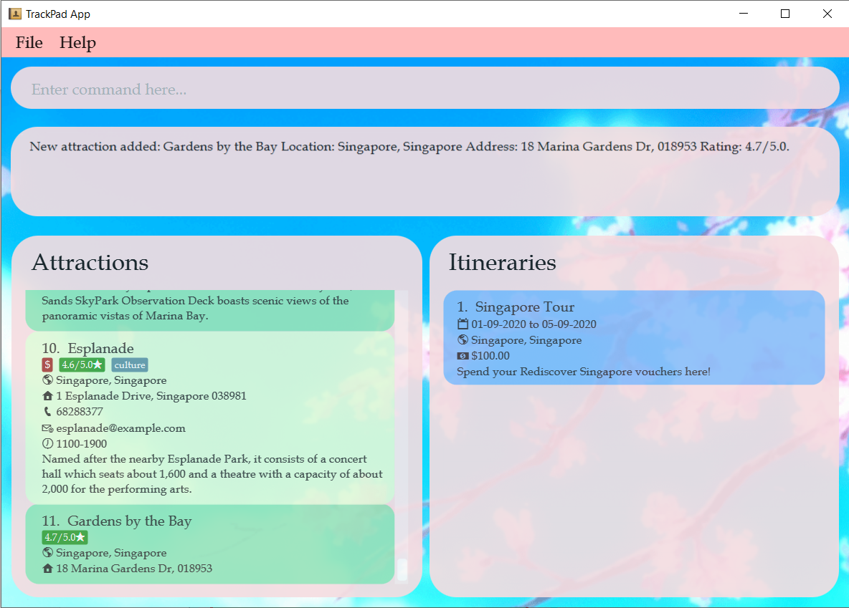
Confirmation message if the command is successful
New attractions are added to the bottom of the list

Slide 2
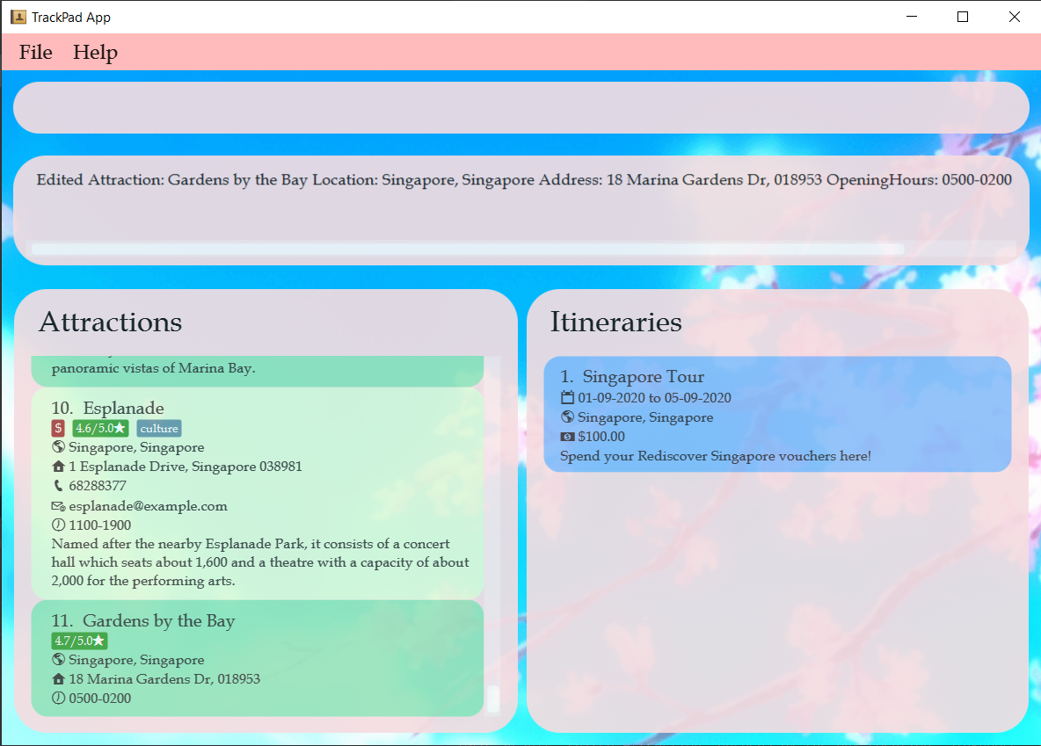
Opening Hours
added

Slide 3
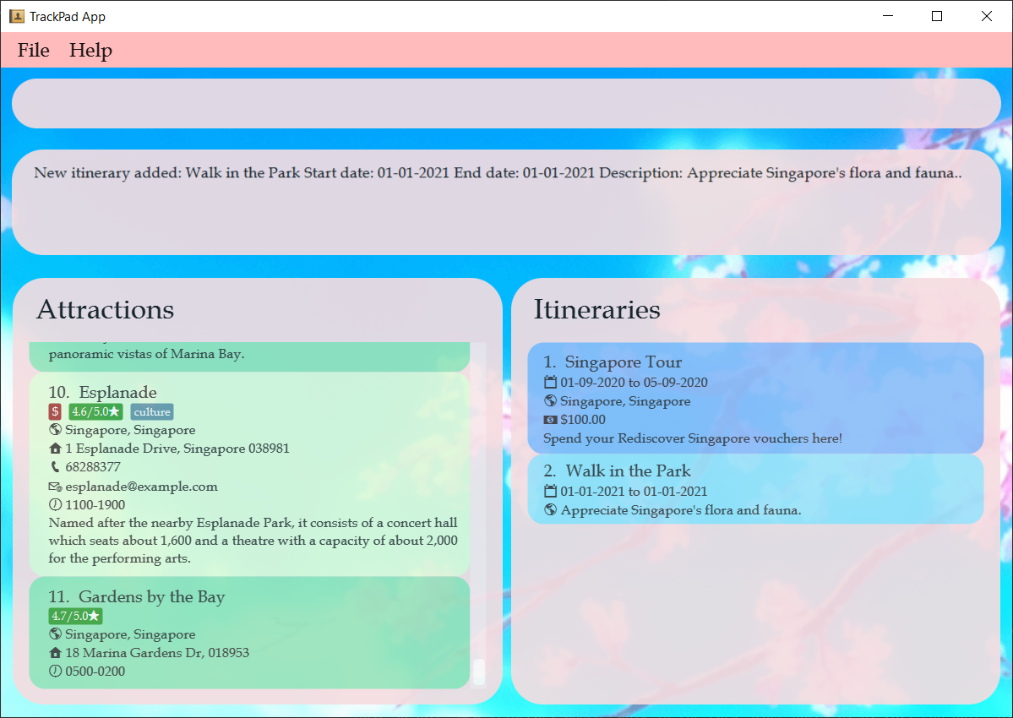

Confirmation message
New itinerary has been created!

Slide 4
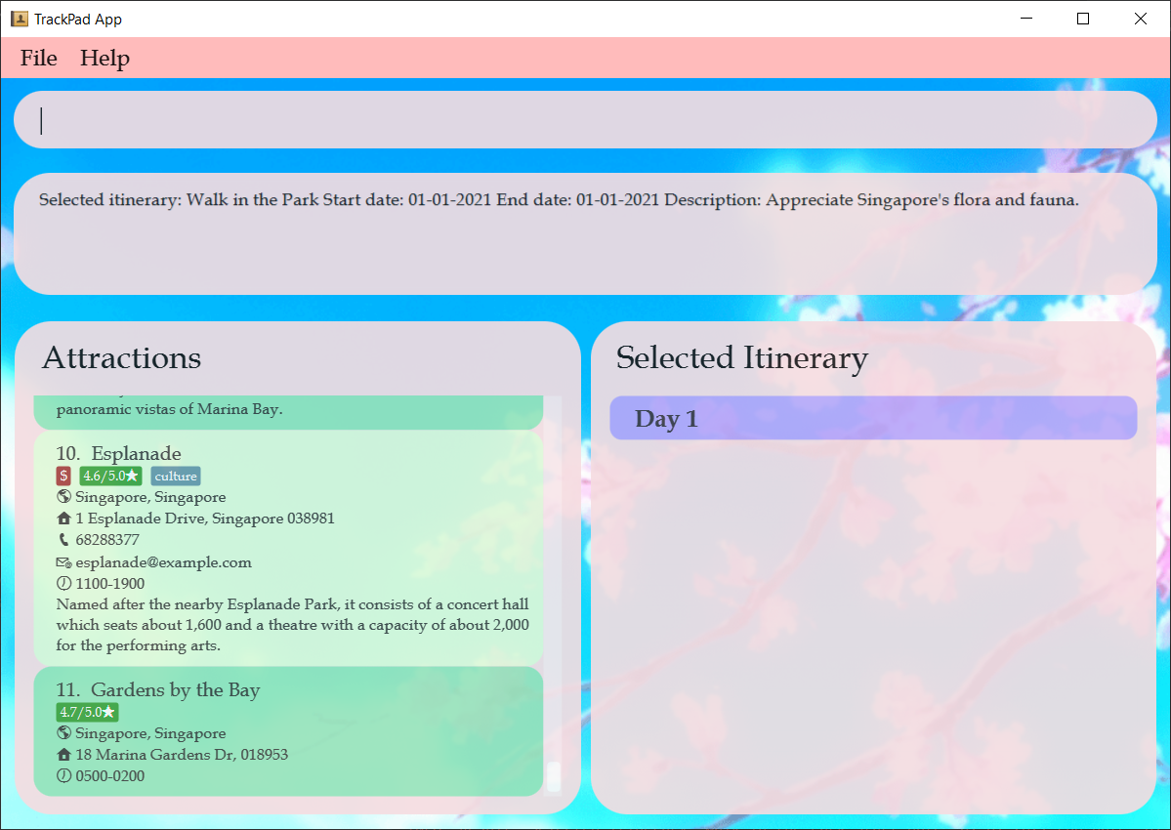
Indicates that you have selected an itinerary to view

Slide 5
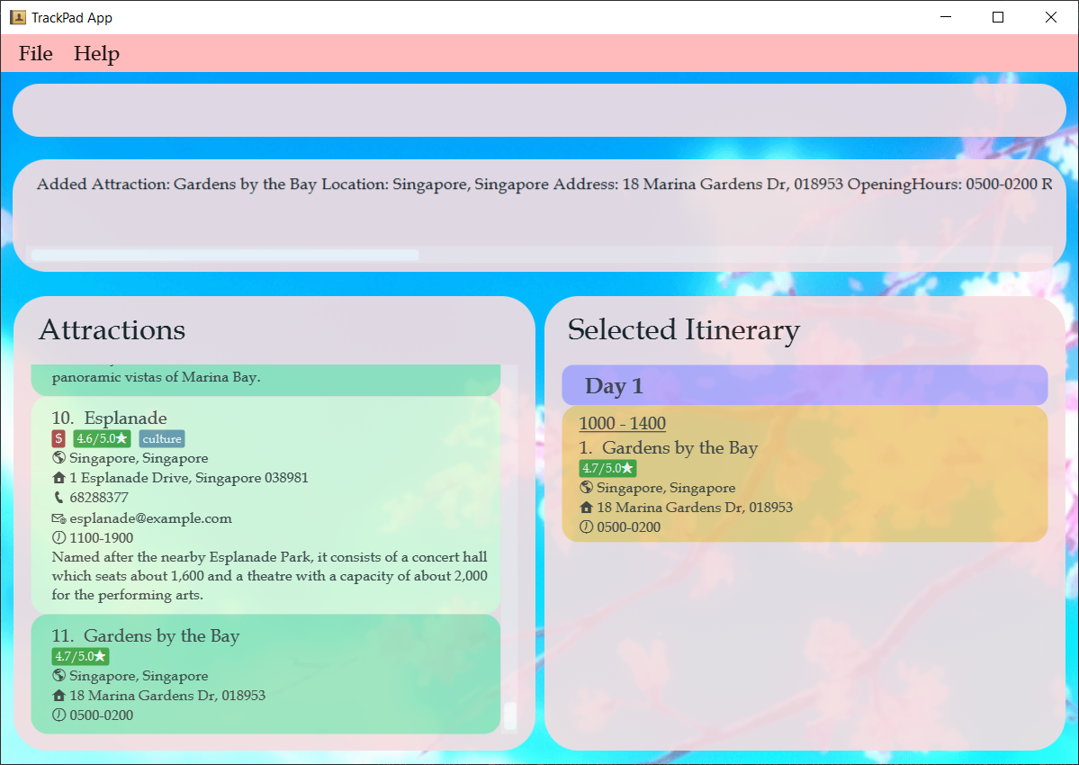
Time of planned visit
Gardens by the Bay added

